Slide 1
SVM-KM: speeding SVMs learning with a priori cluster selection and k-means
Marcelo Barros de Almeida, Antônio de Pádua Braga, João Pedro Braga
IEEE Transactions on Neural Networks 882-890, Volume: 20, Issue: 5, May 2009
Presenter : Chih-Ying Lin
Date : Jan. 26, 2010

Slide 2
Abstract(1/2)
A procedure called SVM-KM, based on clustering by k-means and to accelerate the training of support vector machines, is the main objective of the work. During the support vector machines (SVMs) optimization phase, training vectors near the separation margins, are likely to become support vector and must be preserved. Conversely, training vectors far from the margins are not in general taken into account for the SVM's design process. SVM-KM groups the training vectors in many clusters. Clusters formed only by a vector that belongs to the same class label can be disregard and only cluster centers are used.

Slide 3
Abstract(2/2)
On the other hand, clusters with more than one class label are unchanged and all training vectors belonging to them are considered. Clusters with mixed composition are likely to happen near the separation margins and they may hold some support vectors. Consequently, the number of vectors in a SVM training is smaller and the training time can be decreased without compromising the generalization capability of the SVM

Slide 4
Method

Slide 5
Method

Slide 6
Method

Slide 7
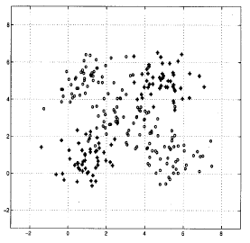
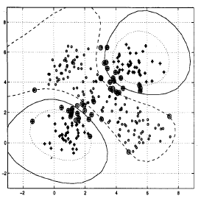
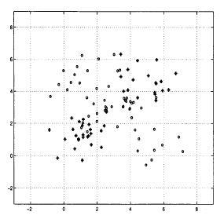
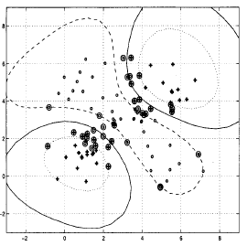
Simulation

Slide 8
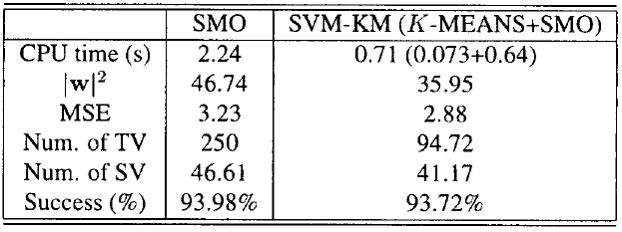
Result

Slide 9
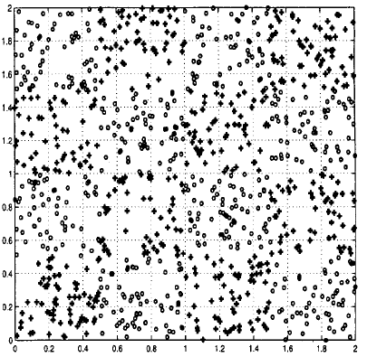
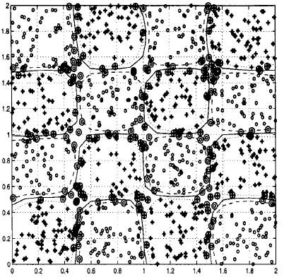
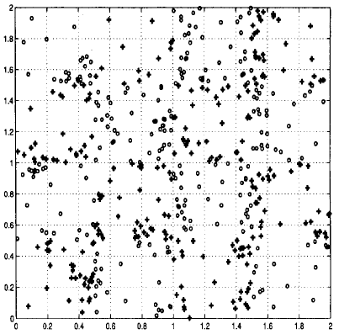
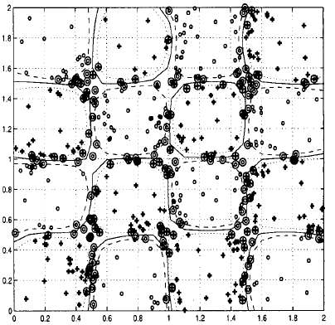
Simulation

Slide 10
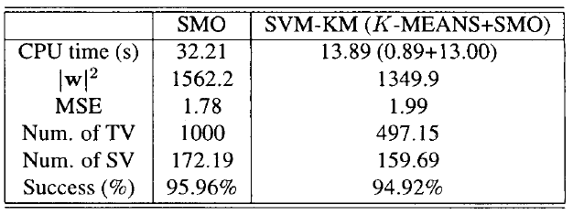
Result

